Slide 2
No Rings (17.5mm clad OD)

Slide 3
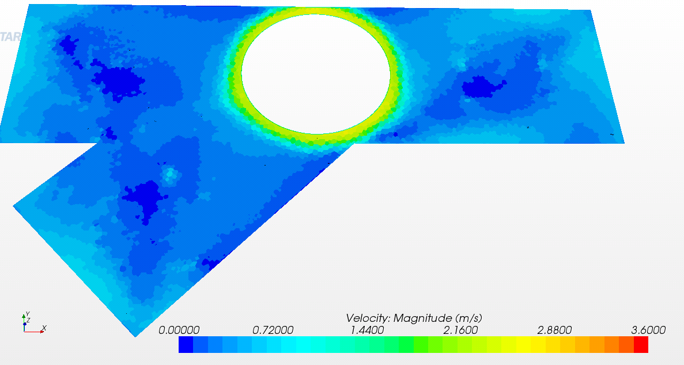

Slide 4
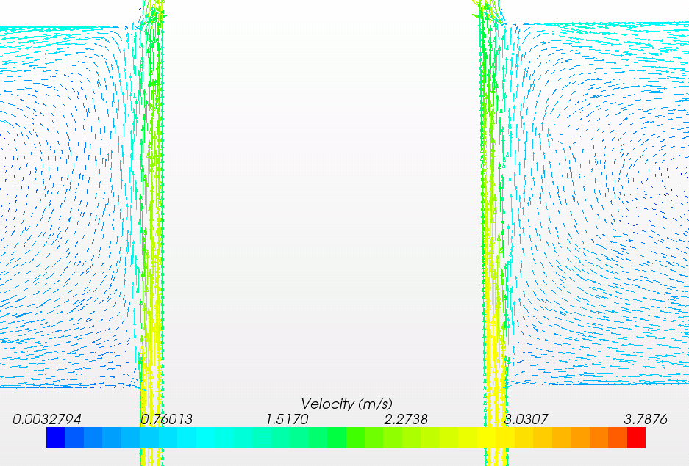

Slide 5
With only 0.5 inch sample ring (17.5mm clad OD)

Slide 6
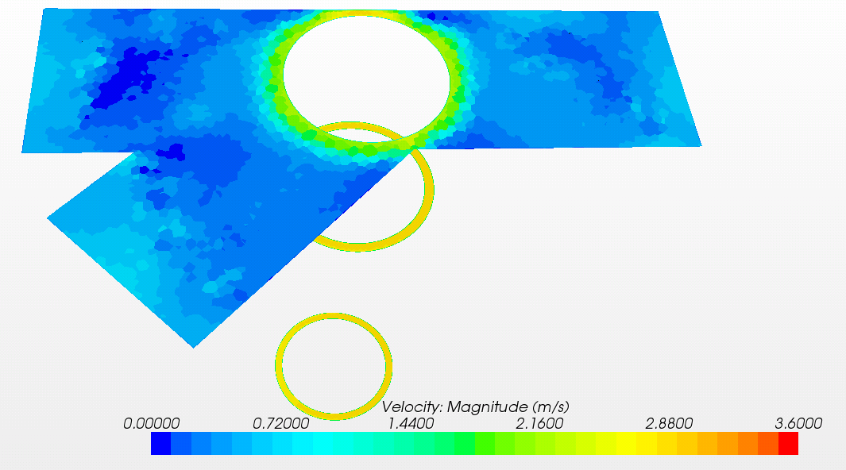

Slide 7
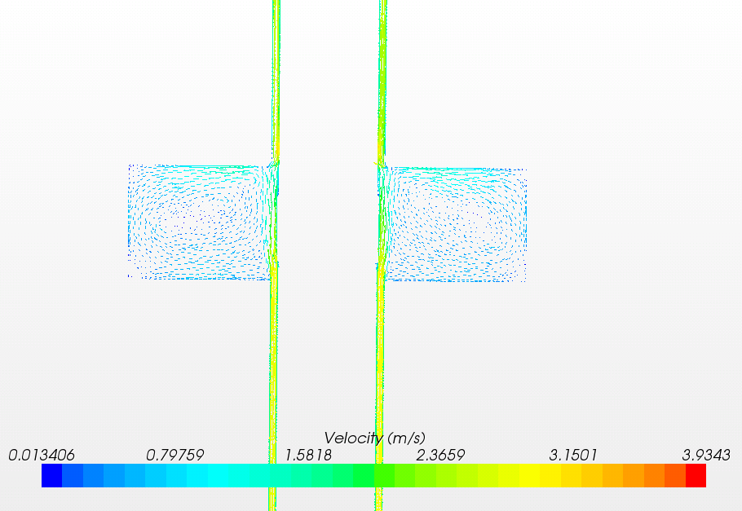

Slide 8
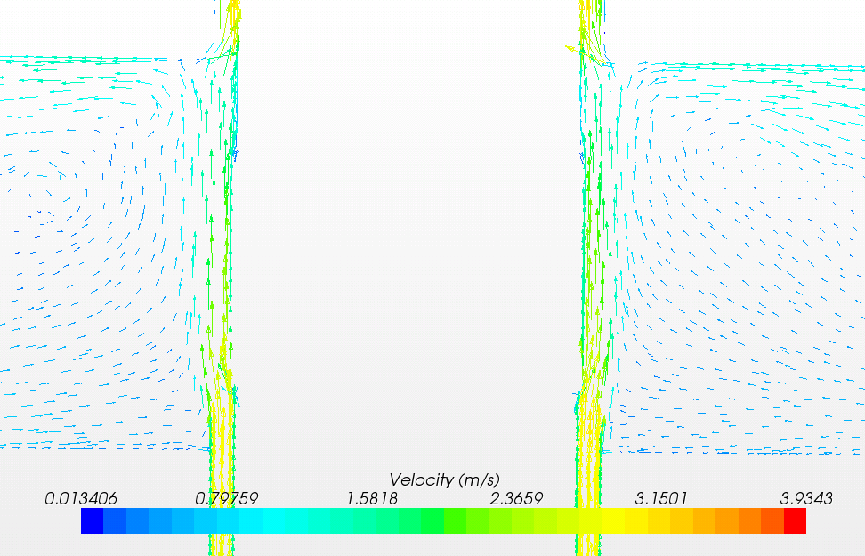

Slide 9
Sample ring+ 5cm flow ring on bottom (17.5mm clad OD)

Slide 10
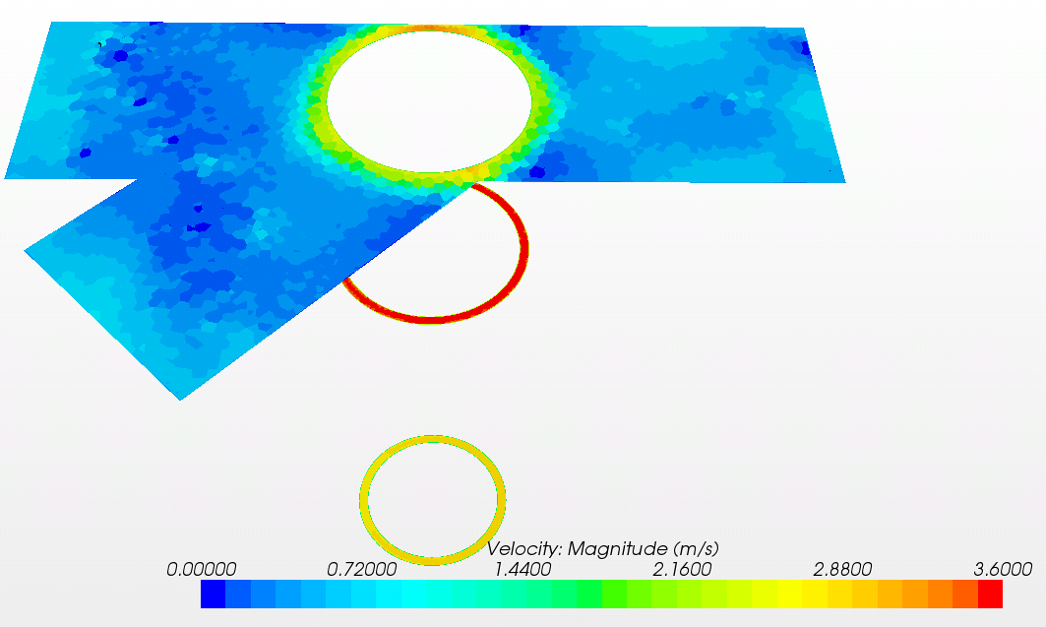

Slide 11
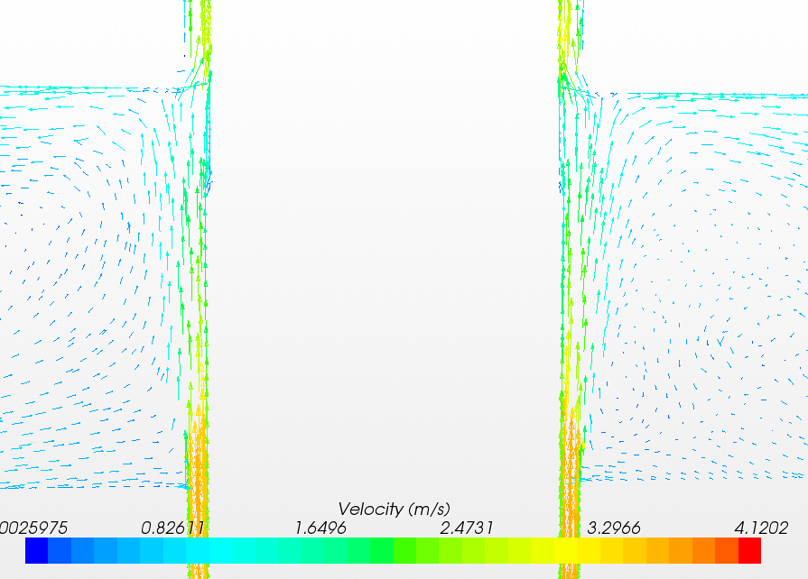

Slide 12
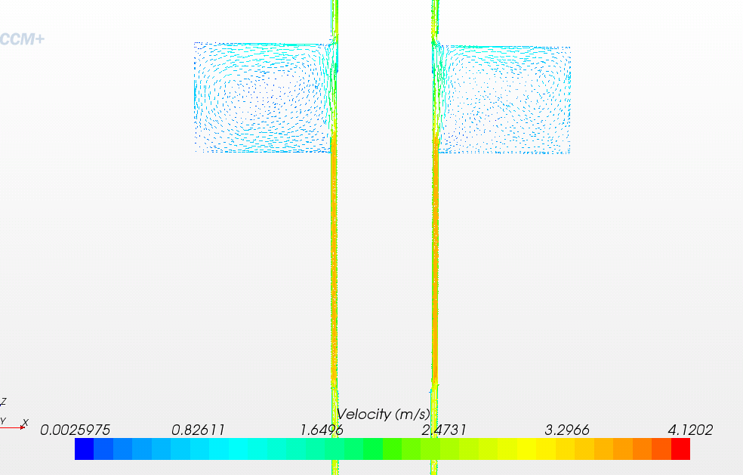

Slide 13
Two flow rings and sample ring in between (17.5mm clad OD)

Slide 14
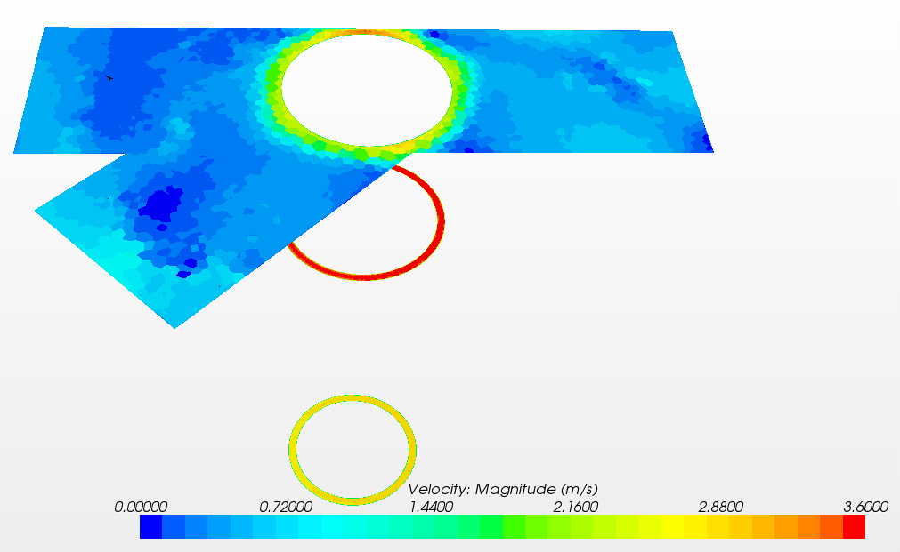

Slide 15
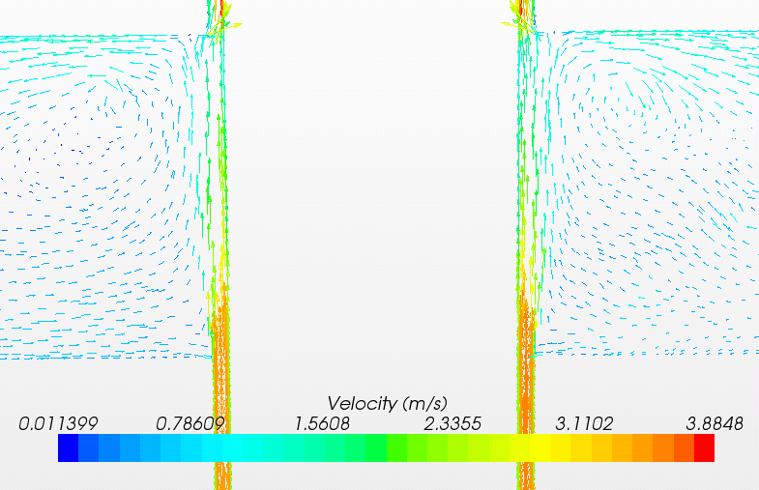

Slide 16
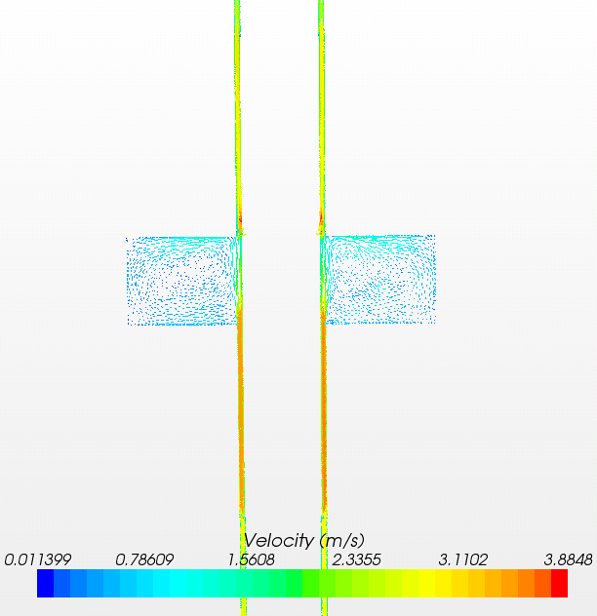

Slide 17
Two flow rings+sample ring 17.4mm OD

Slide 18
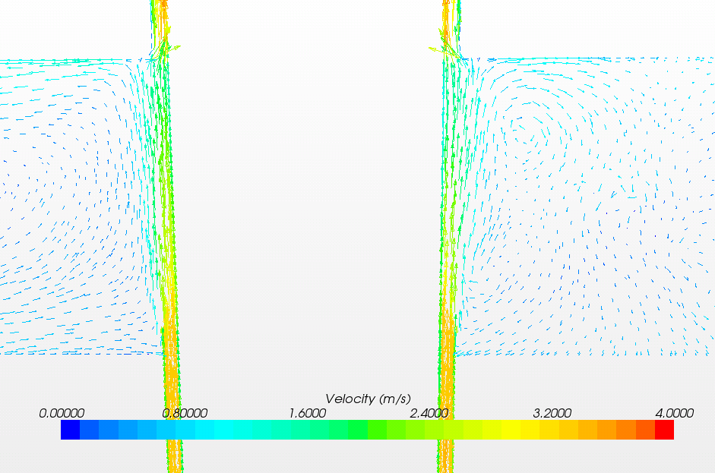

Slide 19
